Slide 1
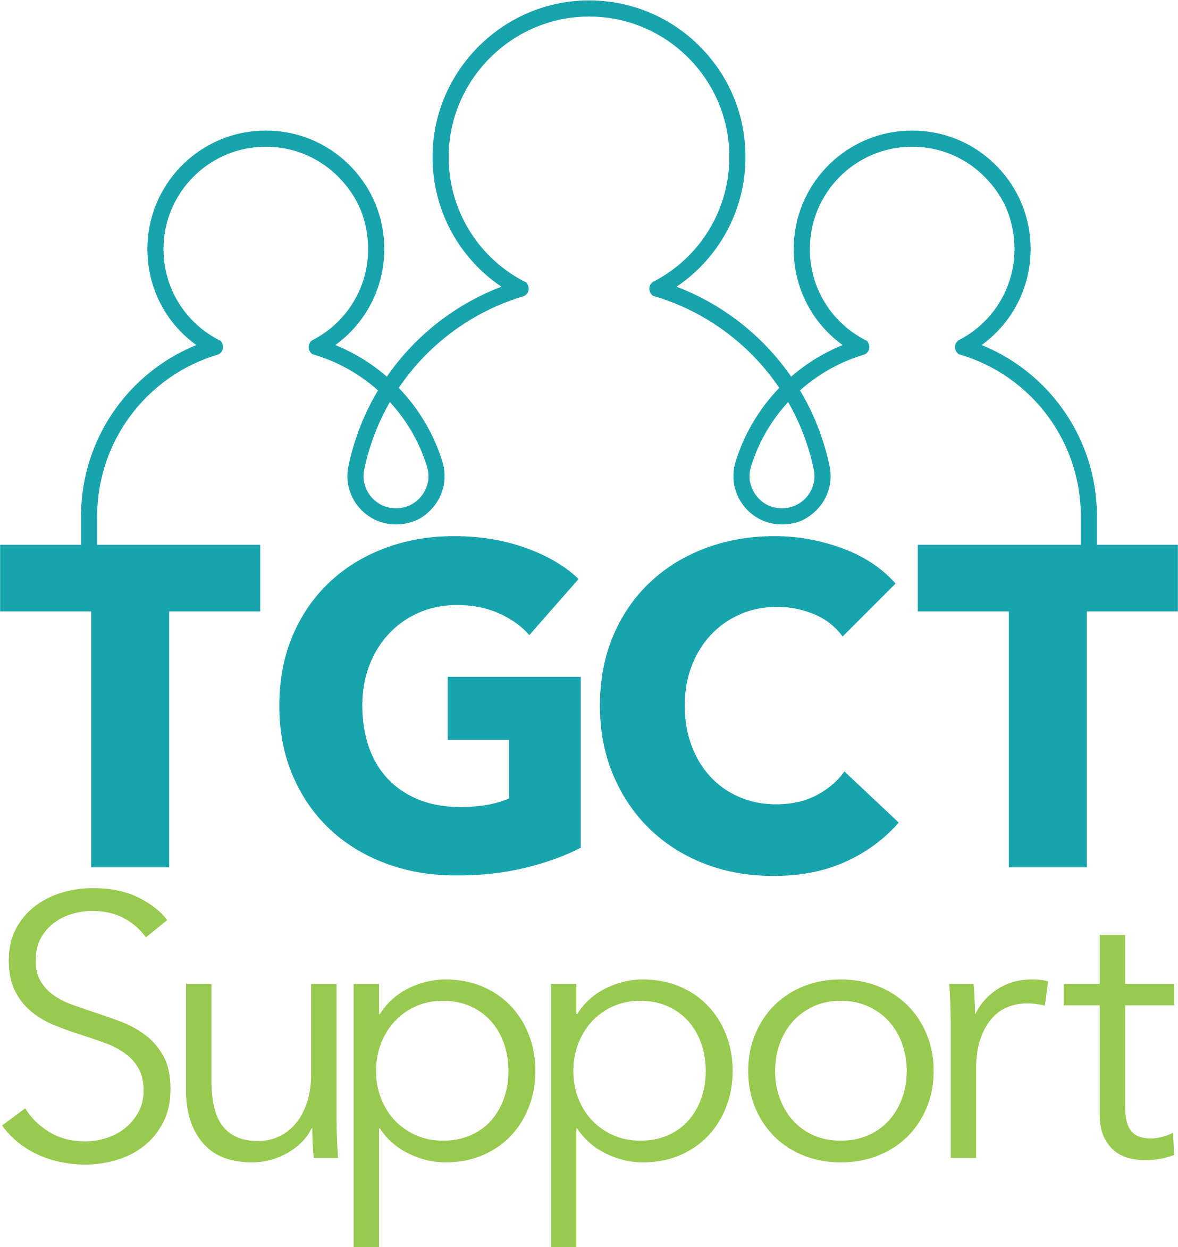
TGCT Support Registry: Lessons Learned
Sydney Stern, PhD

Slide 2
TGCT Facebook Group
“Would you change your diet to make a medication more effective?”
Sydney + LRG + TGCT community
Dec 2019

Slide 3
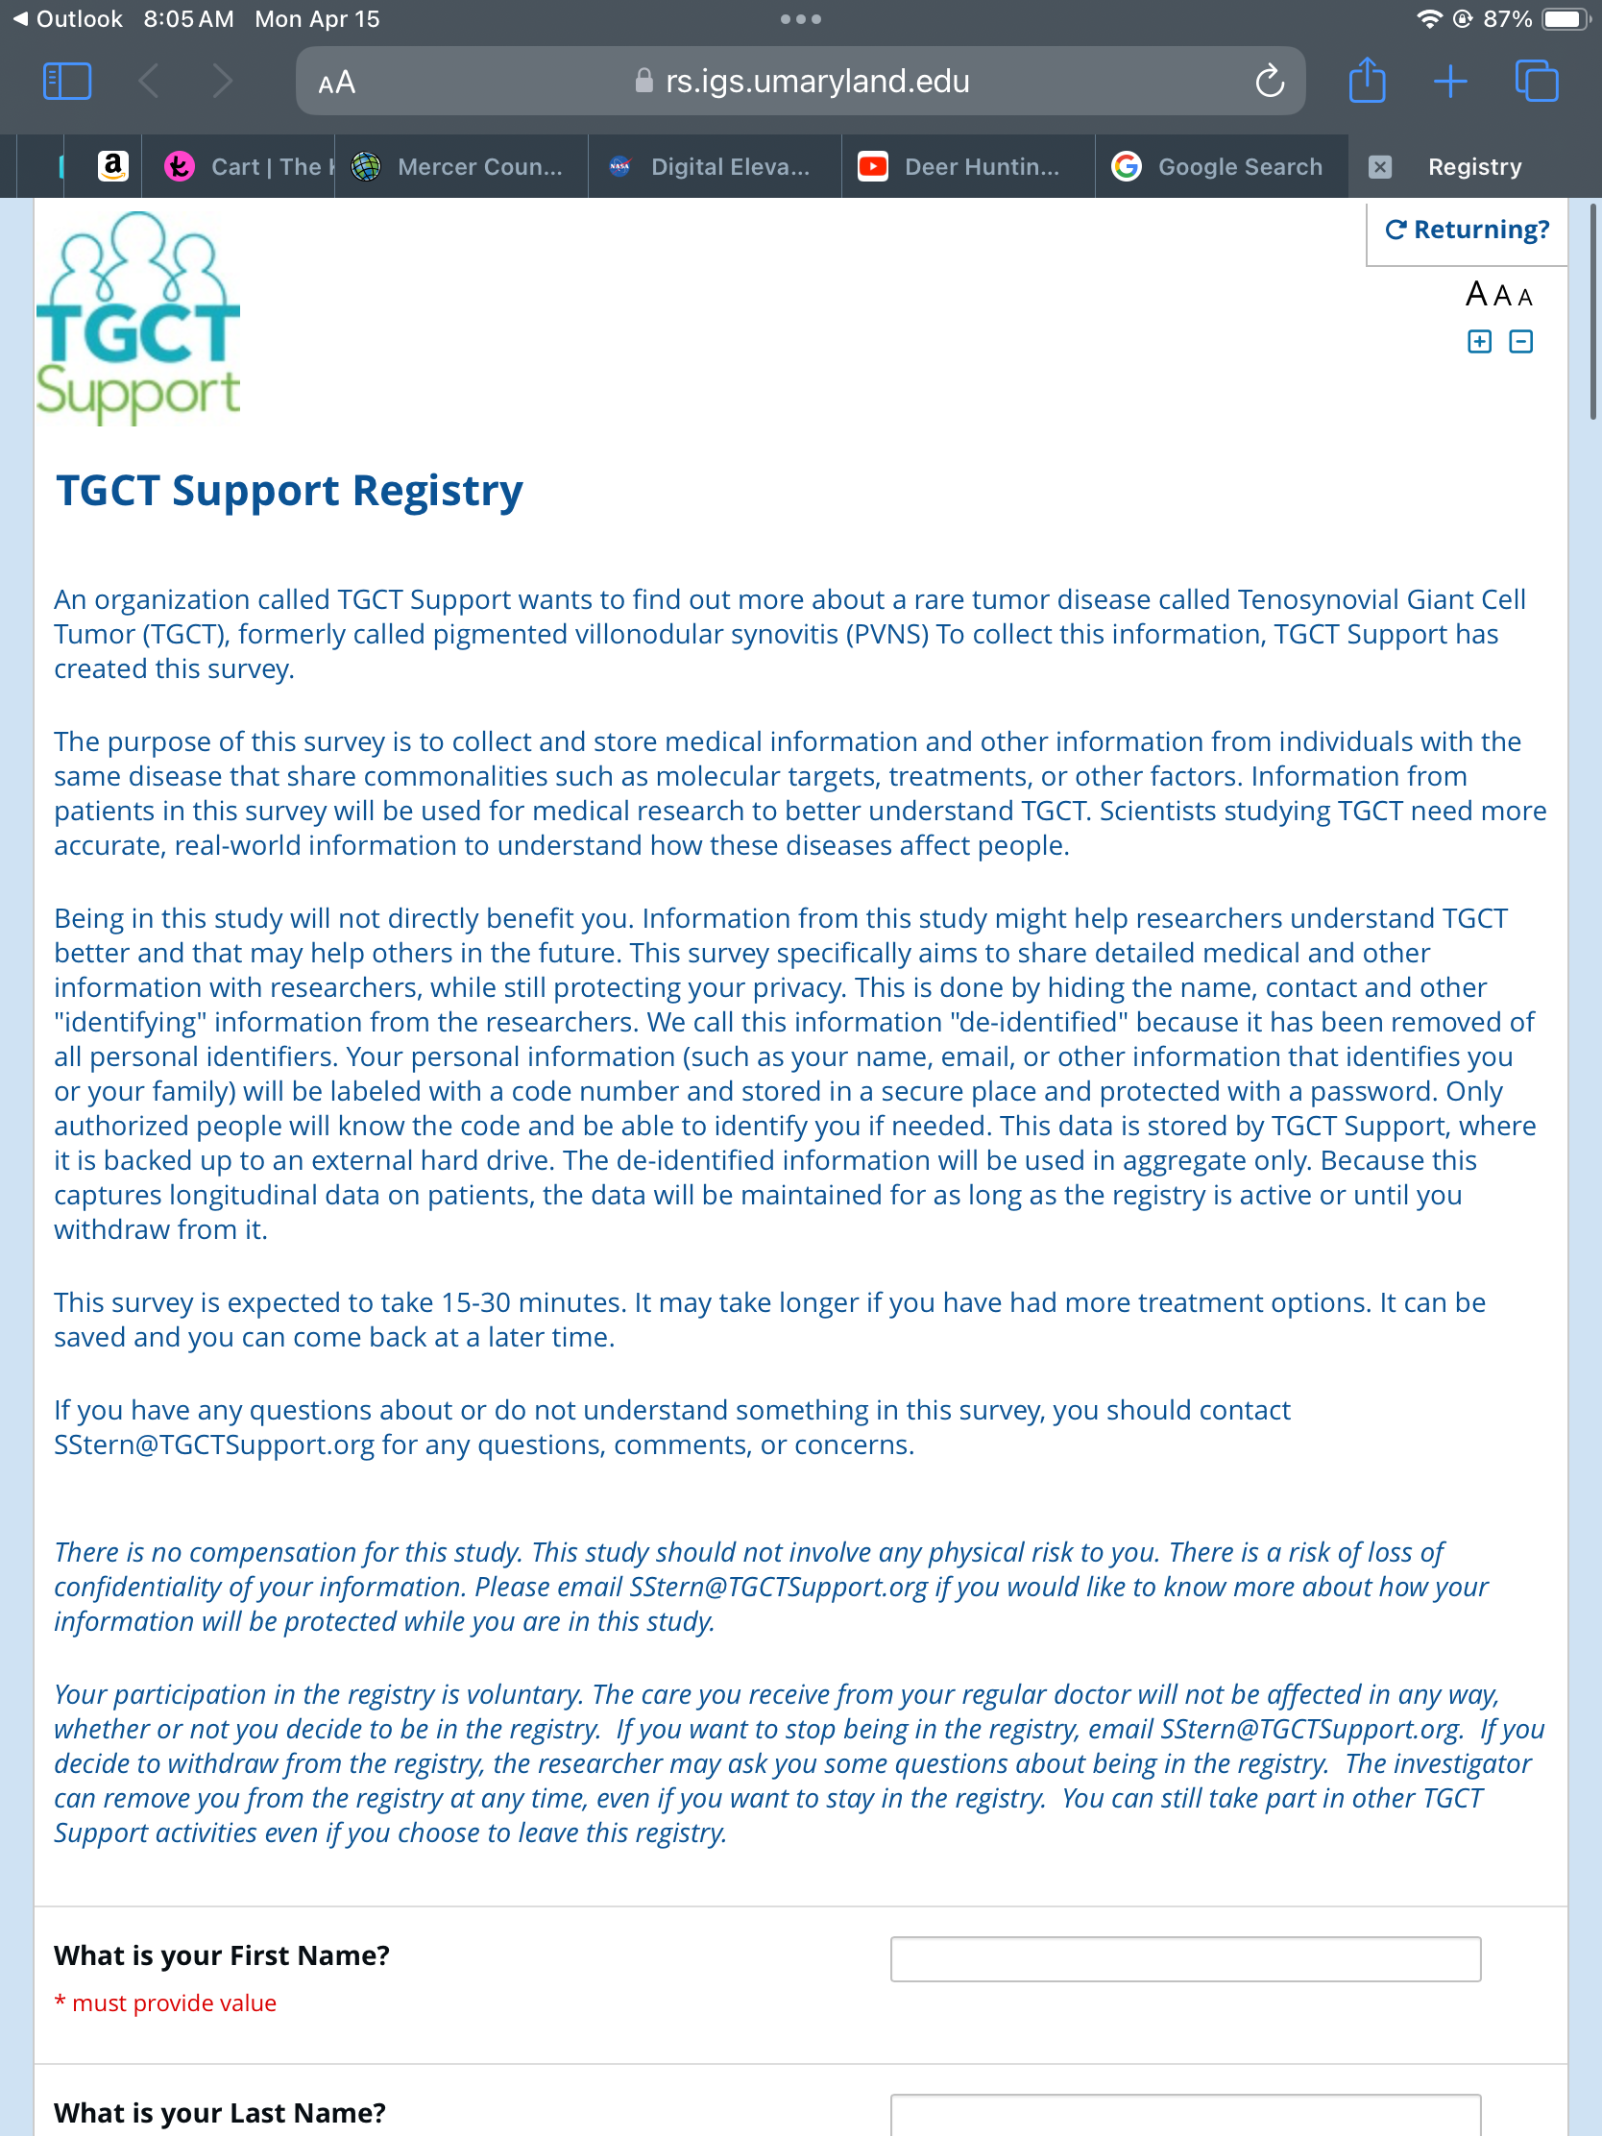
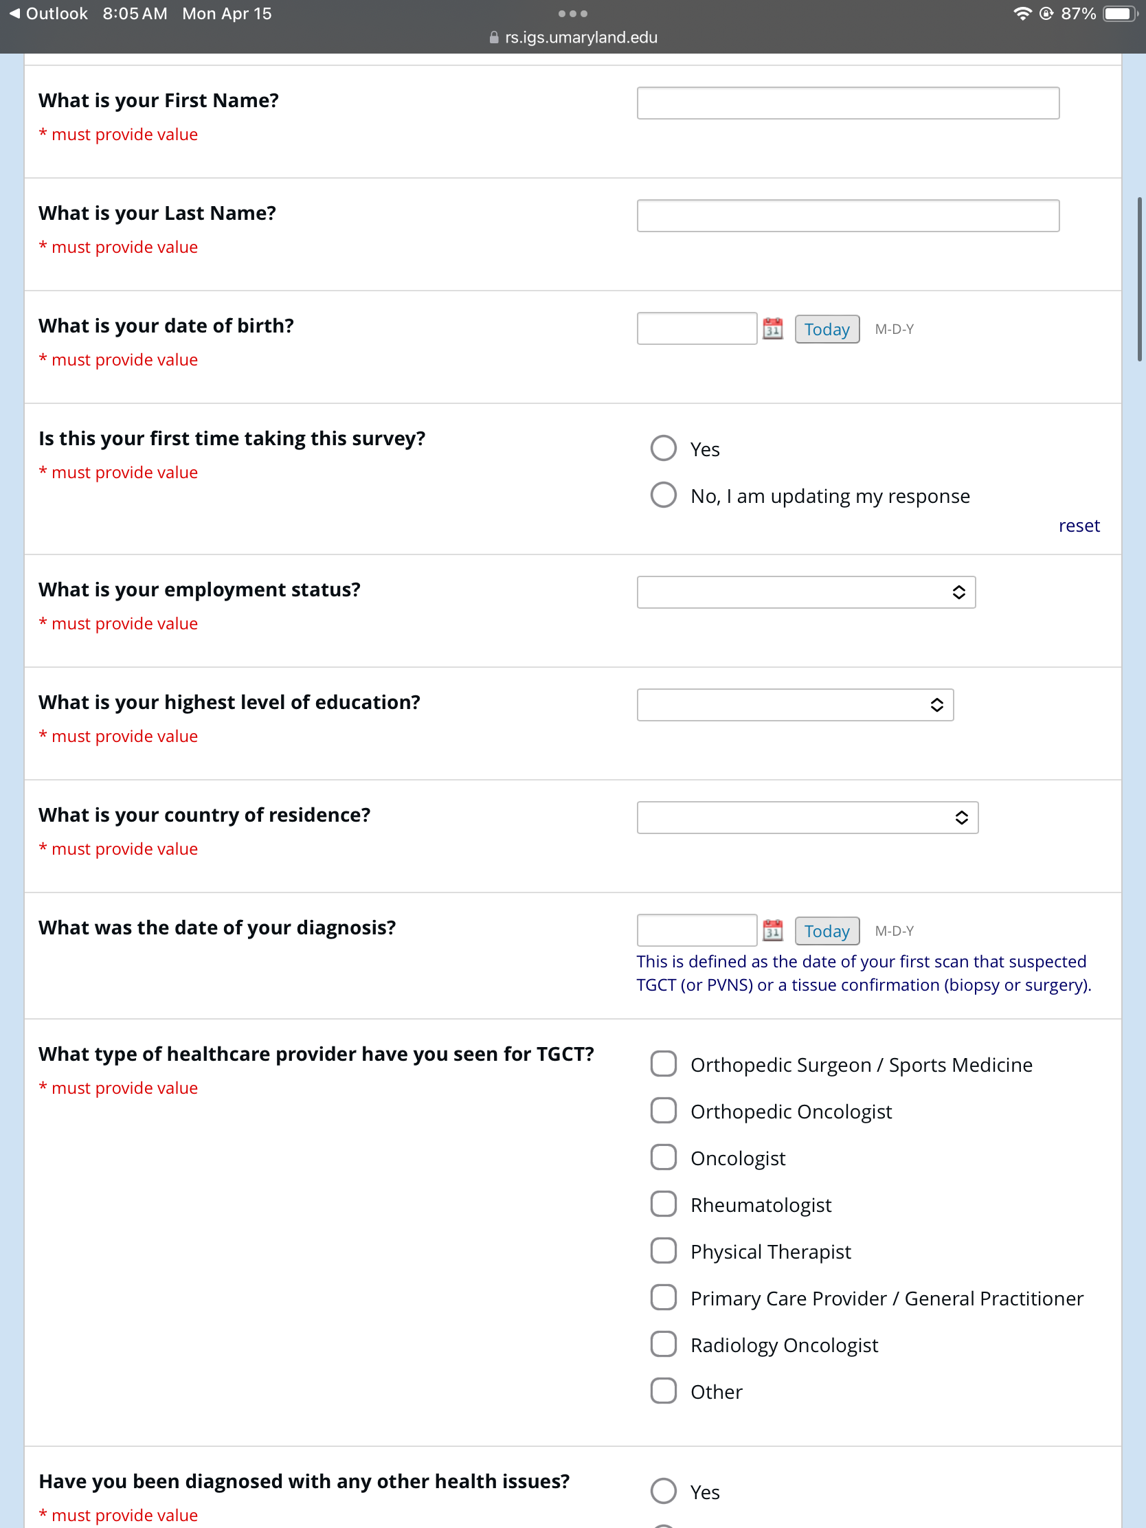

Slide 4
OBJECTIVE: Honor patients’ lived experiences while fulfilling requirements for real world evidence that benefit patients directly
Add structure to an unstructured world
Create a quantitative natural history with structured questions that engage all patients at all stages of disease
Developed a registry with more than 900 patients in under 2 years
Many patients enter registry before their first treatment
1/4th on medications
Nearly half are non-US patients

Slide 5
Challenges
Validated questions left little to be desired from patient perspective
Global differences in nomenclature and classifications (e.g., race and ethnicity)
Demonstrating global needs while considering influence of individual healthcare systems
Continued engagement with patients so they feel personal responsibility to success of registry
Disseminate information in a way that continues to honor patients, exemplifying patient powered research, transparency, and scientific rigor

Slide 6
Best Practices
Keep patients at the forefront (can’t go wrong!)
What’s important to patients may not always be obvious
Engage patients early in the design (e.g., pilot survey)
Continued engagement is critical for community trust and success
Use validated questions with mix of new questions (structured vs unstructured)
Think of the statistical plan before you need it

Slide 7
Thank you!
ACKNOWLEDGEMENTS:
Patients with TGCT and their caretakers, Zach, and LRG Special thank you to Amy Hall for beautifying my slides

