Slide 1
Working together to improve sarcoma diagnosis:
A collaborative funding initiative
Dr Zoe Davison, Bone Cancer Research Trust

Slide 2
The challenge
Sarcomas are challenging to diagnose.
they can affect anyone
occur anywhere in the body
over 100 subtypes
present with a diverse range of symptoms.
1 in 3 patients wait at least 6 months to receive an accurate diagnosis of sarcoma
Patients experience long delays in receiving a correct diagnosis of sarcoma, with many given incorrect diagnoses.
On average bone sarcoma patients visit a health care professional 8 times, before receiving a diagnosis
The Bone Cancer Research Trust and Sarcoma UK have highlighted research into diagnosis within their organisational strategies.
“By 2033 all patients will have an accurate and timely diagnosis”
In prioritisation exercises carried out by Sarcoma UK and the Bone Cancer Research Trust, research into diagnosis is highlighted as a high priority for people affected by sarcoma.
“Prioritising research into the early diagnosis of sarcoma”

Slide 3
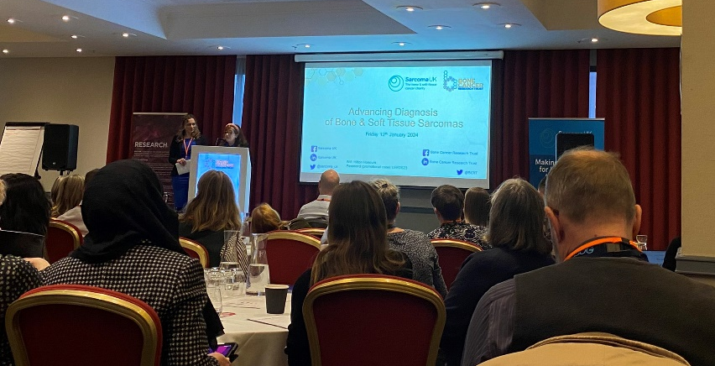
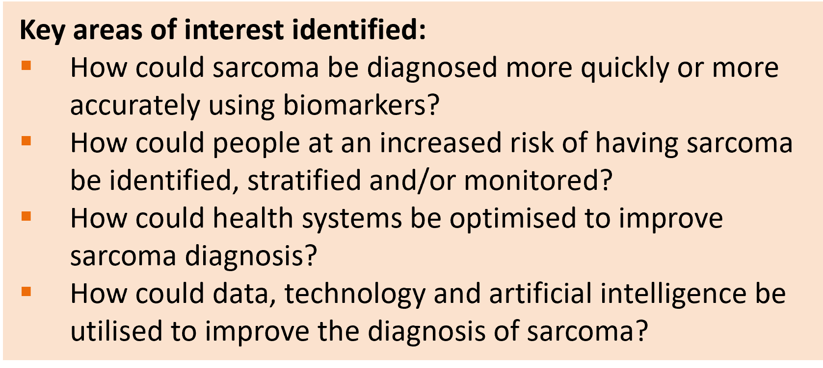
Shaping a funding call to address this challenge
Whilst we know that improving diagnosis is a priority for our communities, research funding in this area to date has been limited & advancements lacking.
Together, the BCRT and Sarcoma UK set out to shape a funding call to advance diagnosis of bone & soft tissue sarcomas and ultimately improve outcomes for patients.
Key learnings
Period of consultation with experts across the fields of sarcoma and Screening, Prevention & Early Detection (SPED).
Joint meeting of over 70 experts held in January: patient advocates, researchers and clinicians.
Opportunity to jointly debate & agree upon key areas of interest, with the patient perspective central to discussions.

Slide 4
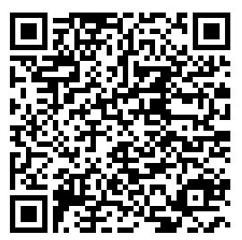
Joint funding call NOW OPEN
The Improving Sarcoma Diagnosis funding round is the result of these collaborative discussions, shaped by the key learnings and priorities shared amongst patient advocates, researchers & clinicians.
It aims to fund scientific and clinical research projects seeking to drive a positive change in how sarcomas are detected and diagnosed.
Total budget: £500,000
Scope: projects applicable to all types of sarcoma or bone sarcoma only.
Grant Types: Small grants (max £100,000), Large grants (max £250,000)
Deadline 20th June 2024
Please scan the QR code for further information or contact
research@sarcoma.org.uk research@bcrt.org.uk
Thank you.

