Slide 1
#5 FOR PROJECT
A series of trainings psycho-oncology for various stakeholder groups related to helping cancer patients.
SPAGN ANNUAL CONFERENCE ROME 2024

Slide 2
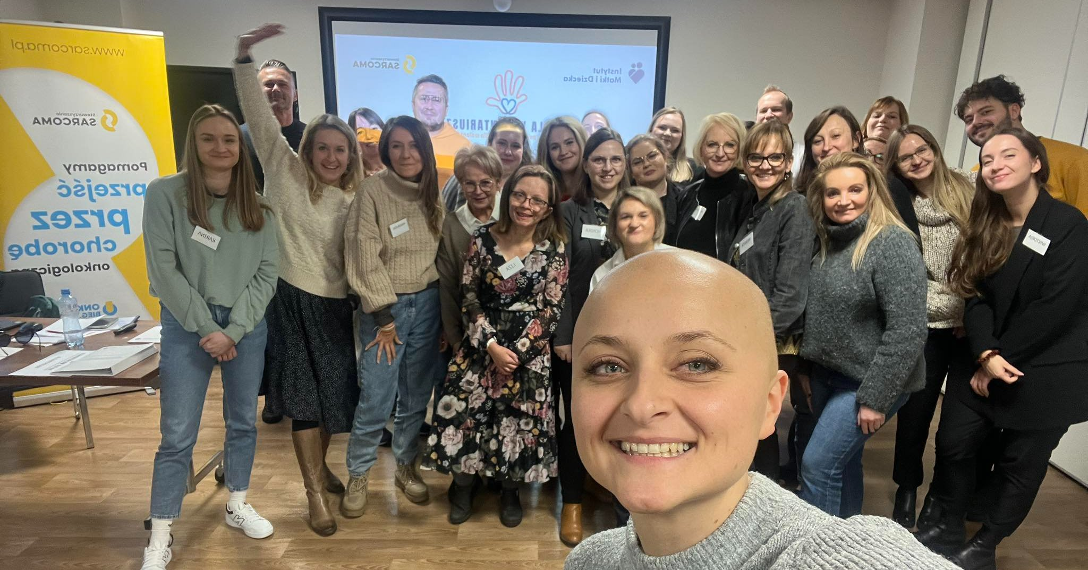
AIMS
The aim of this project is to increase knowledge in the field of pediatric oncology and is dedicated to nurses, volunteers, teachers, and psychologists.

Slide 3
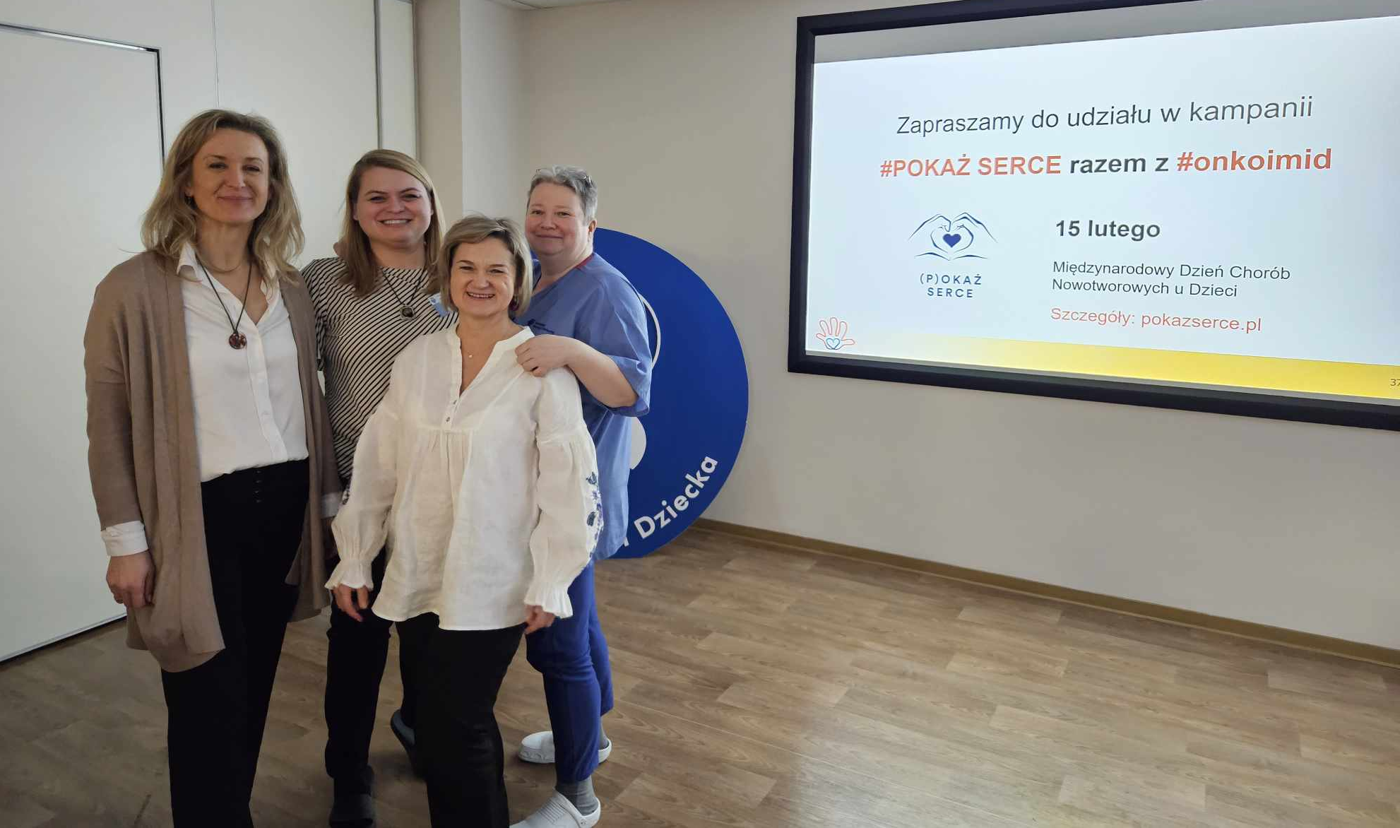
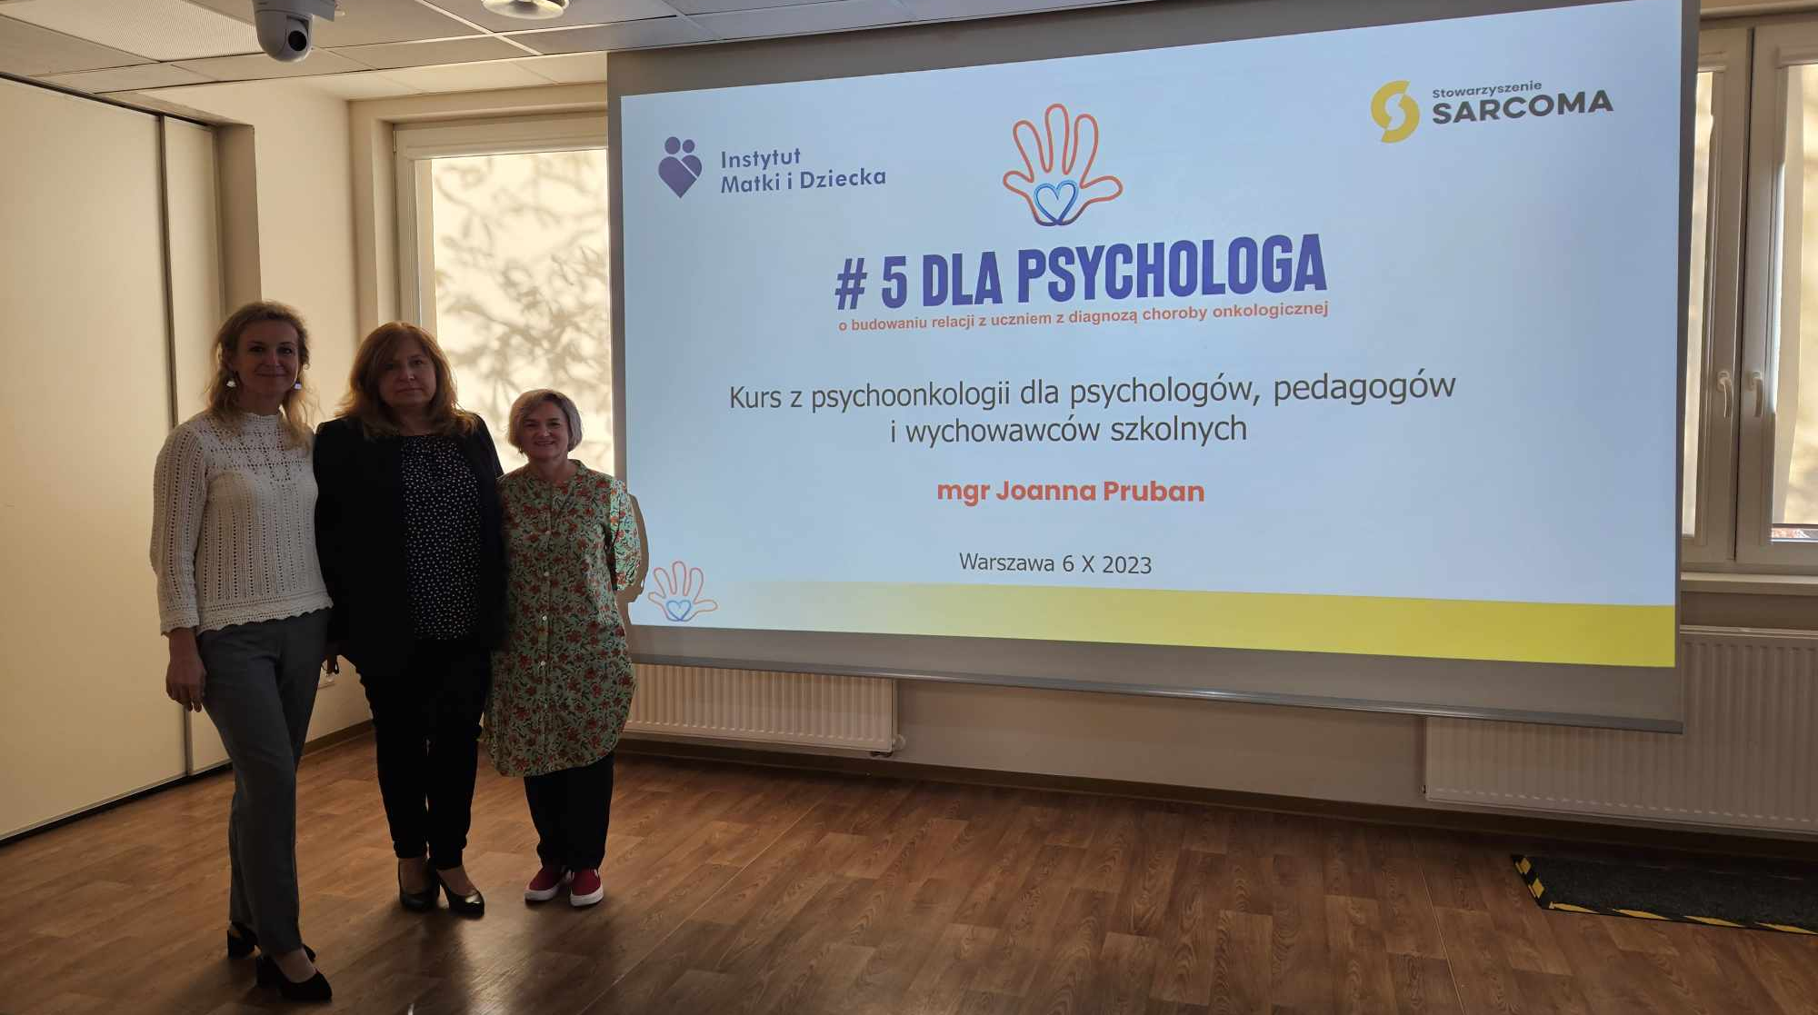
WHAT HAVE WE DONE?
We created a series of trainings, where members of the Sarcoma Association and specialists from the Institute of Mother and Child share knowledge about understanding the treatment process, the psychosocial impact of the disease, and effective mental support strategies for patients and their families. The project also includes lectures for young people whose friends are facing cancer.

Slide 4
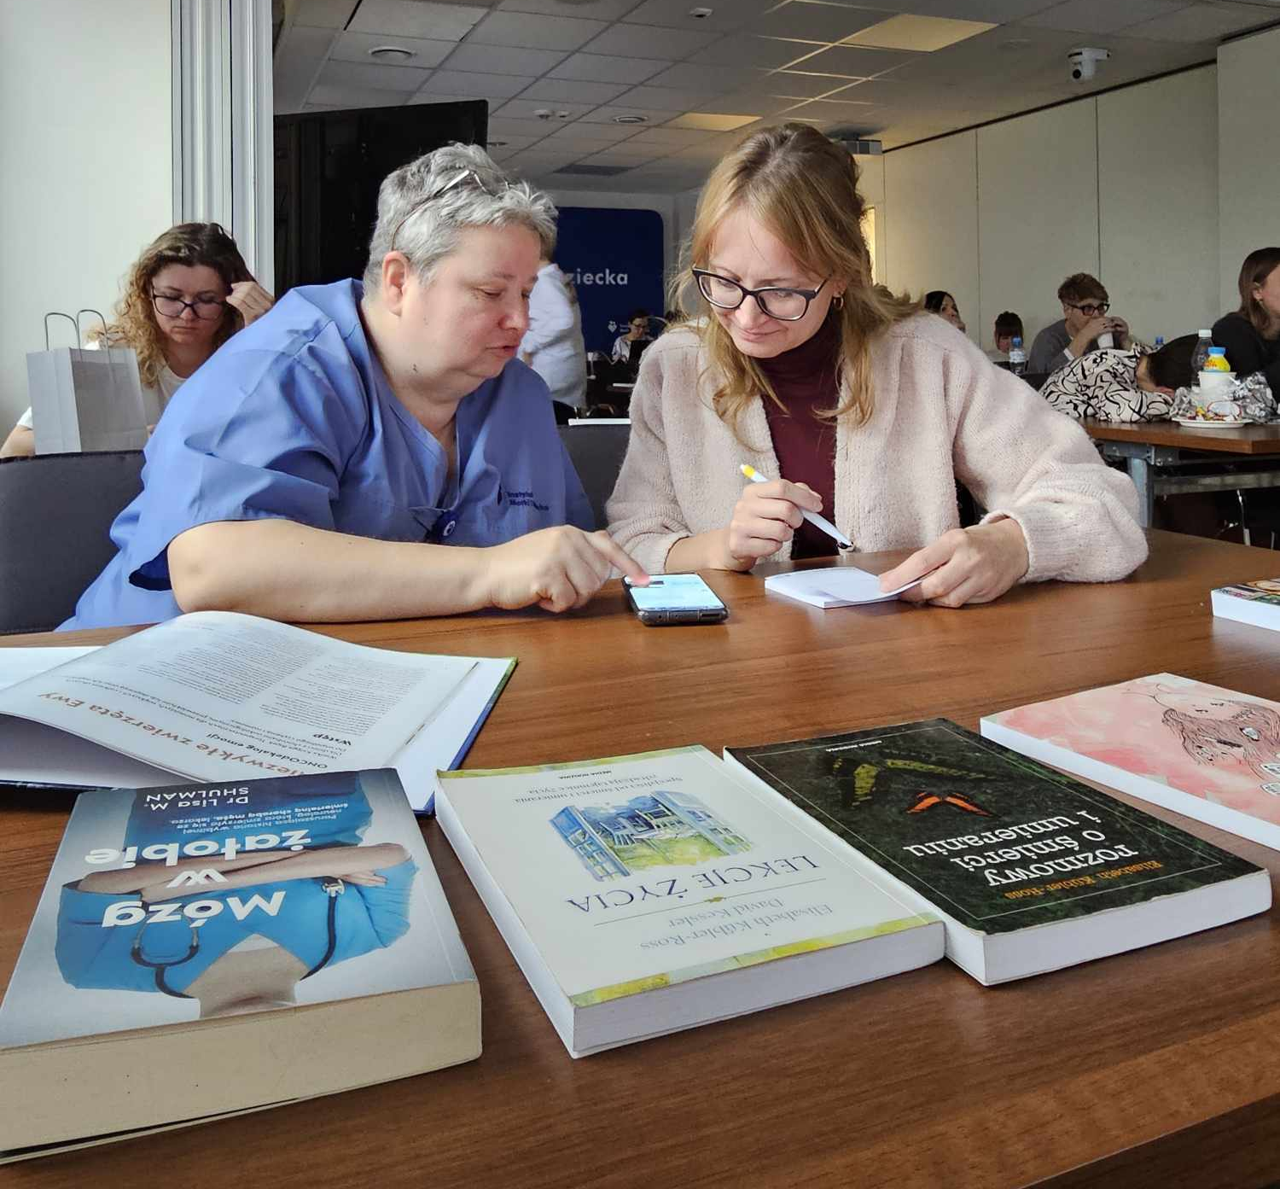
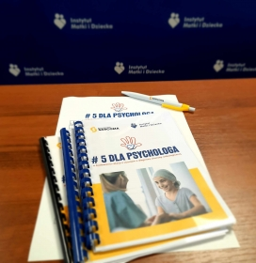
HOW WE ENGAGED STAKEHOLDERS?
Each participant receives educational materials, including a thematically dedicated and adapted guidebook. Each training includes a moderated discussion to exchange participants' experiences.

Slide 5
WHY WE DO THIS PROJECT?
We have three main reasons for supporting sarcoma patients. Firstly, we understand the importance of self-help. Secondly, we appreciate the countless individuals and organizations involved in assisting sarcoma patients. Finally, we recognize that the rarity and complexity of these diseases can leave loved ones feeling helpless, and we want to provide them with the support they need.

Slide 6
THANK YOU FOR YOUR ATTENTIONS

