Slide 1
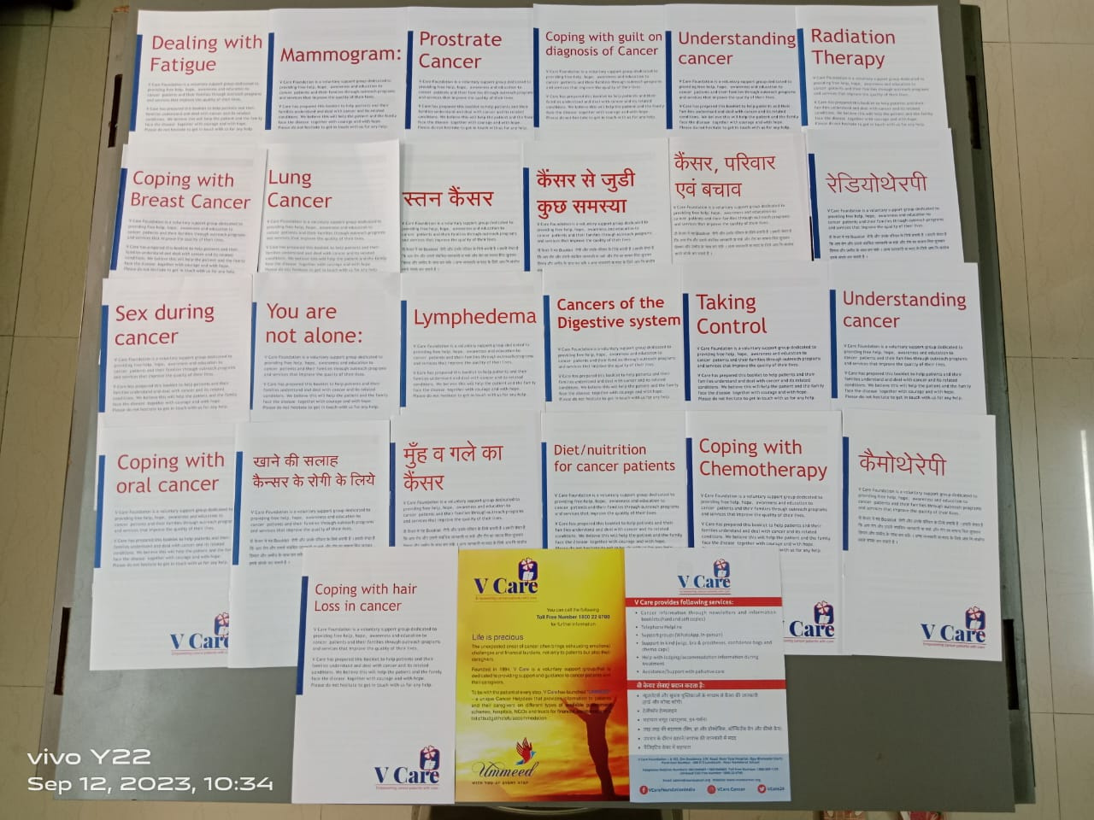



Jankari & Salah - The Knowledge Spot
V Care Foundation, India

Slide 2
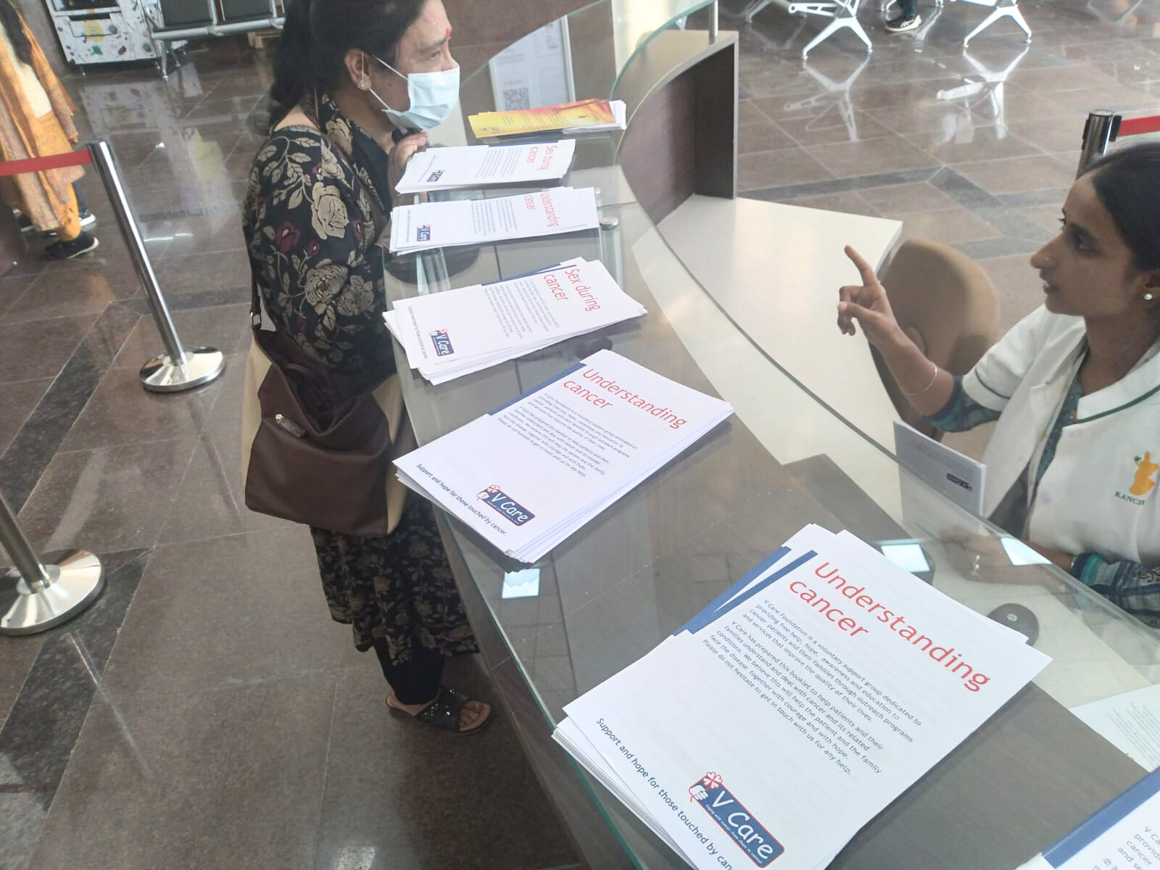
About the Project
  Information booklets cover a wide range of emotional and cancer related topics. These are provided on a pro bono basis.
  These are sent to the hospitals or healthcare providers which are at various locations in India.
  There are more than 36 titles that are available.

Slide 3

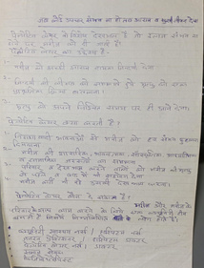
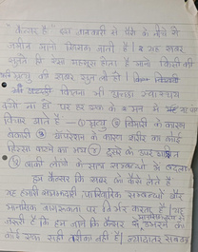
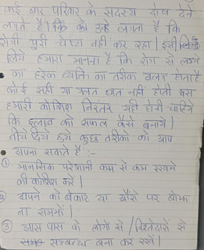
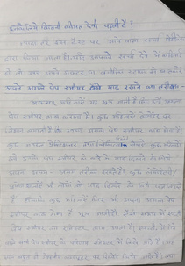
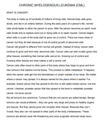
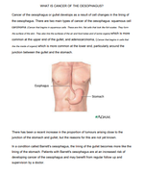
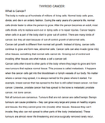
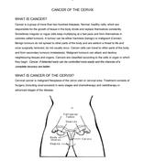










Handwritten sheets
Phases of Information Booklets at V Care
Printed
Information sheets
Colour Booklets
Single Colour Information Booklets

Slide 4

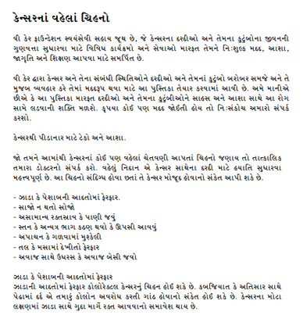
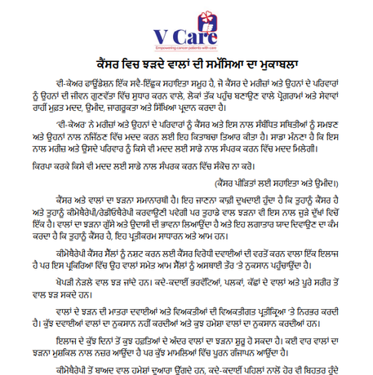


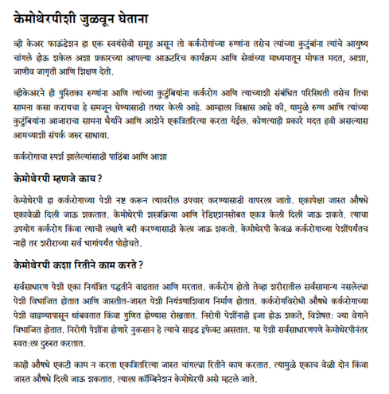
6 Different Languages
Gujarati
Hindi
Gurumukhi
Bengali
English
Marathi

Slide 5
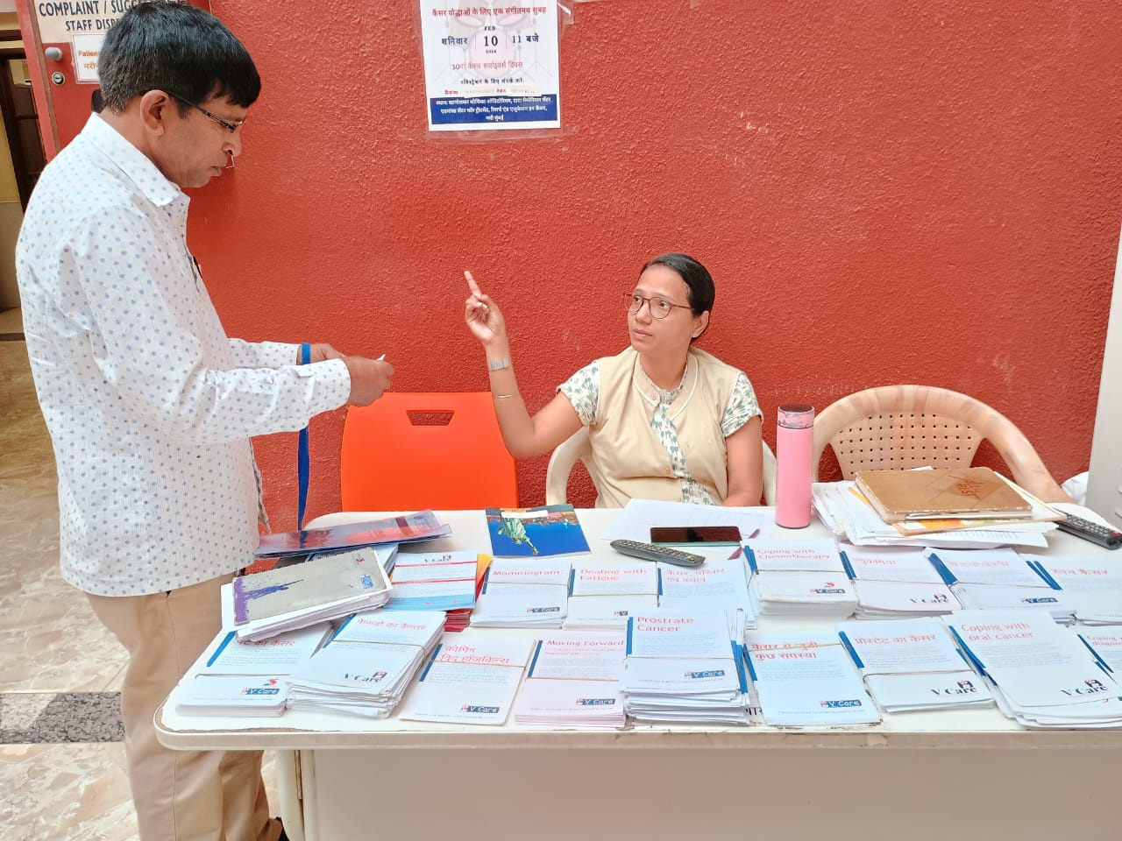


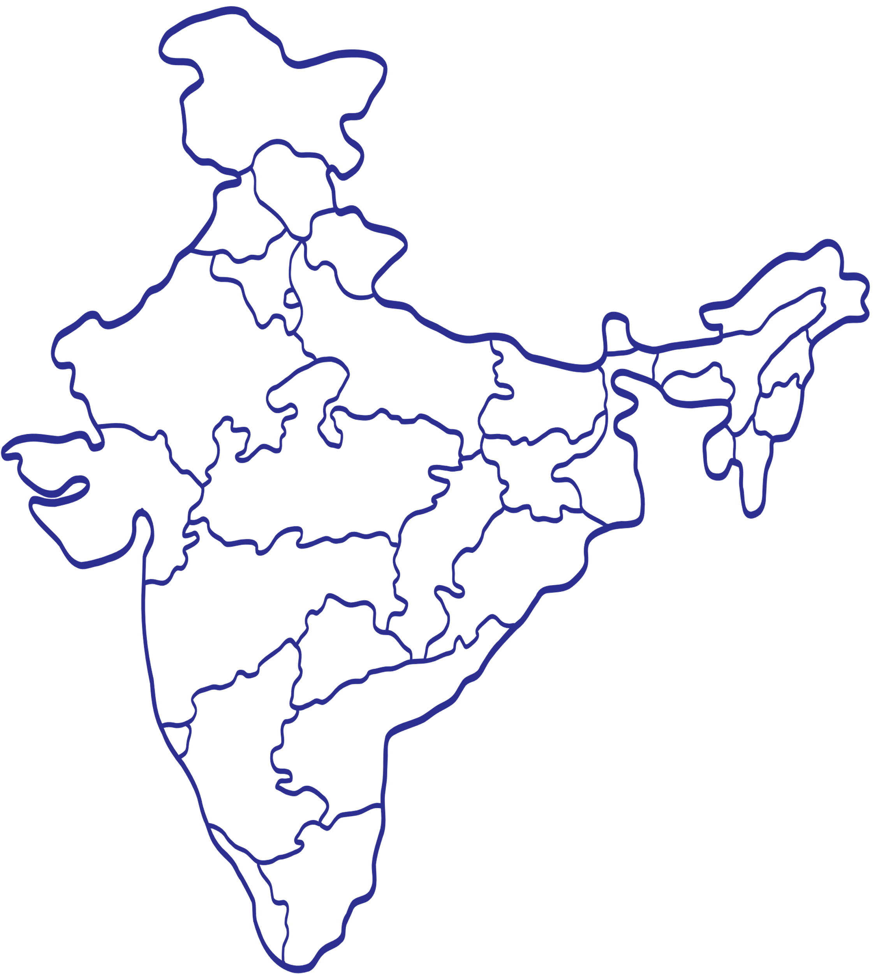

Last
Years
6 States
14 Hospitals
We have supported
796,769
(796k) patients
Chandigarh
Varanasi
Assam
Kolkata
Impact
Mumbai
Kolhapur

Slide 6
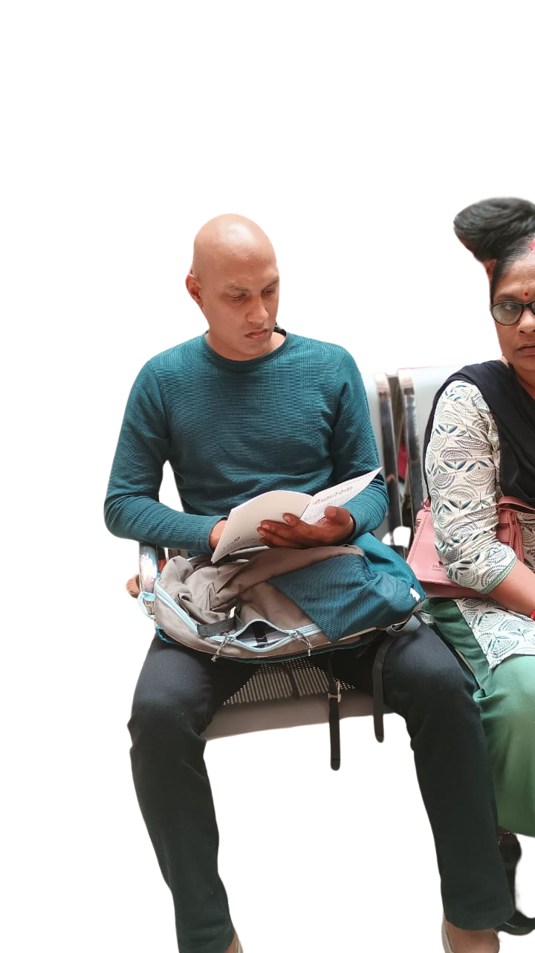

Future Goals
Translation and printing of the English booklets to other regional languages.

Slide 7
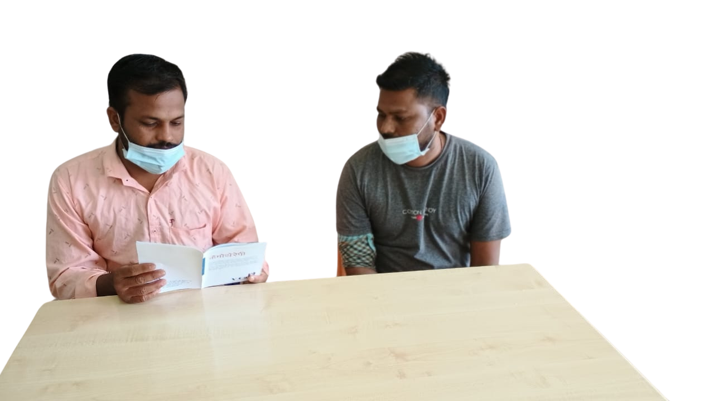
Reach out to us at :
V Care Foundation -- A 102, Om Residency, J.W. Road, St. Xaviers Street, Opp Bhoiwada Court, Parel East, Mumbai - 400 012
Landmark : Near Navbharat School
Facebook: vcarefoundationindia Instagram: vcare.cancer Twitter: @vcare24
Helpline Number: 9821949401 / 9821949402 Ummeed Toll Free Number: 1800-22-6780 Email: admin@vcarecancer.org Website: www.vcarecancer.org

