Slide 1
‘Your guide to follow-up care’
A survivorship focused resource for the primary bone cancer community
Dr Kathleen Kane, Bone Cancer Research Trust

Slide 2
Responding to an unmet need
Loss of confidence
Leading on from research exploring the long-term & late effects experienced by primary bone cancer survivors.
Seeks to address patient-identified gaps in information & support available beyond treatment.
Aims to support patients & families to navigate the survivorship journey by providing evidence-based information shaped by lived experiences.
Fertility
Mental health
Isolation
Kidney issues
Mobility
Hearing
Health anxiety
Chemo brain
Heart problems
Work
Fear of recurrence
Repeated surgeries

Slide 3
Exploring challenges & key learnings
Diversity of survivorship journeys
Incorporating the patient perspective at the earliest opportunity
What is survivorship?
What is follow-up care & why is it needed?
Managing long-term and late effects after surgery
Managing treatment related long-term & late effects
The psychosocial impact of cancer survivorship
Co-design
Shaping realistic expectations
Responding to needs addressed by the community, with the community
Identifying over-arching themes

Slide 4
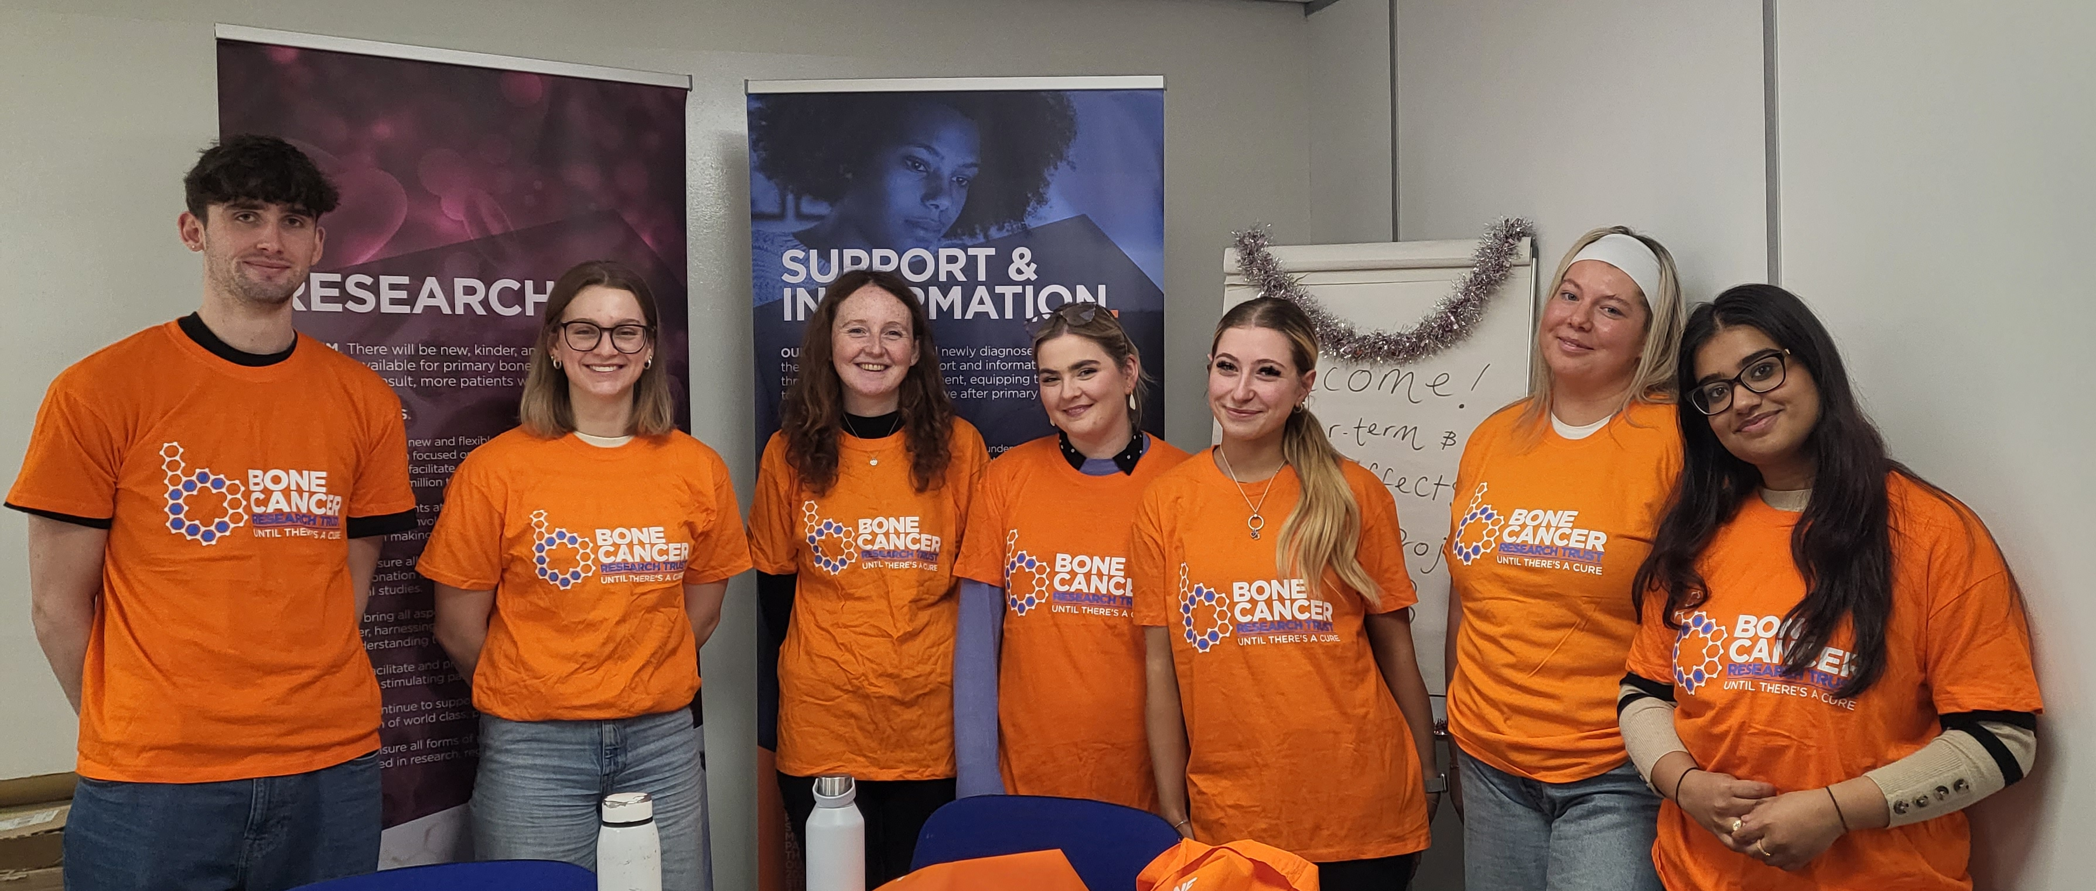
Thank you & acknowledgements
Our sincere thanks to University of Sheffield medical students Sam Clegg, Elora Graham, Isobel Bryson, Emily Holian, Scarlett Hale, Phoebe Potkins & Riya James.
Thank you to our collaborators
Dr Joanne Thompson &
Professor Alison Gartland for their continued support.
For further information please contact research@bcrt.org.uk

