Slide 1



Expert-Verified
Sarcoma Knowledge
On
Social Media
Maria Brandt
German Sarcoma Foundation

Slide 2
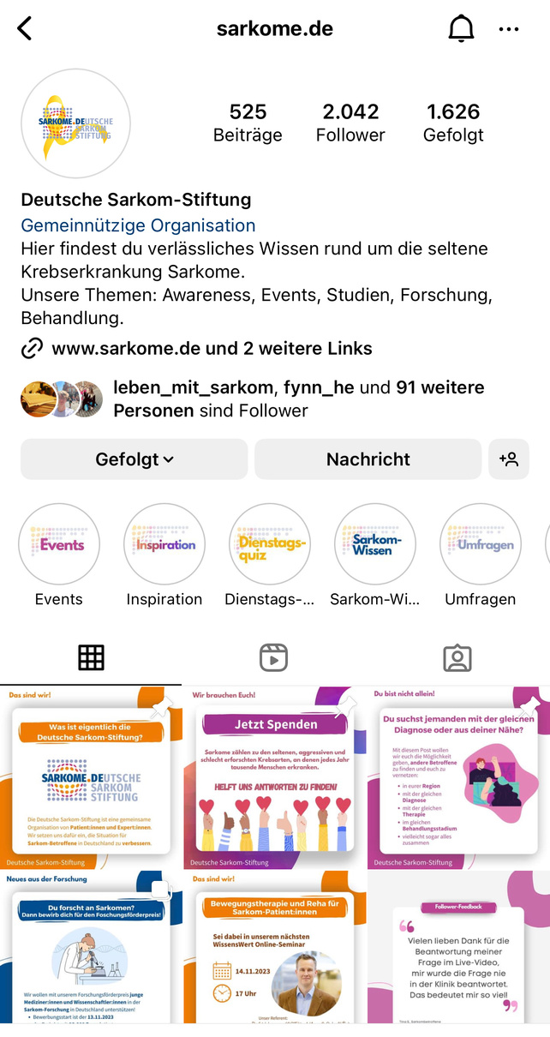
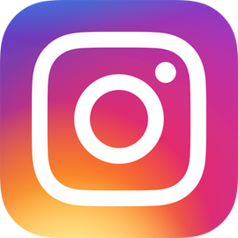
Our Instagram Channel

Slide 3

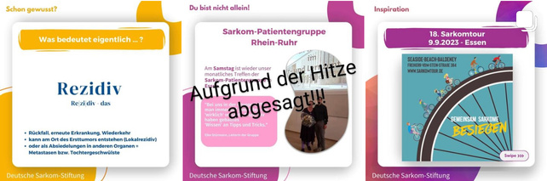
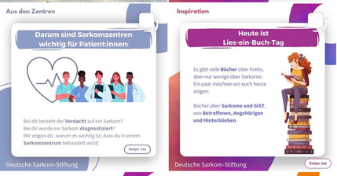
Our Categories
Our Channel Promise
Our numbers
November 2023
  In the last 90 days:
    Over 23,000 accounts reached
    Our posts were viewed over 230,000 times
  That's us!
  Did you know?
  You are not alone!
  Research news
  From the sarcoma centers
  Inspiration
April 2024
"Here you'll find reliable knowledge about the rare cancer disease sarcomas.
Our topics: Awareness, events, studies, research, treatment."
  In the last 90 days:
    Over 46,000 accounts reached
    Our posts were viewed over 390,000 times

Slide 4


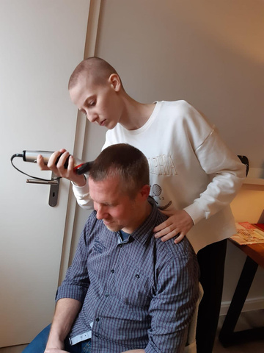
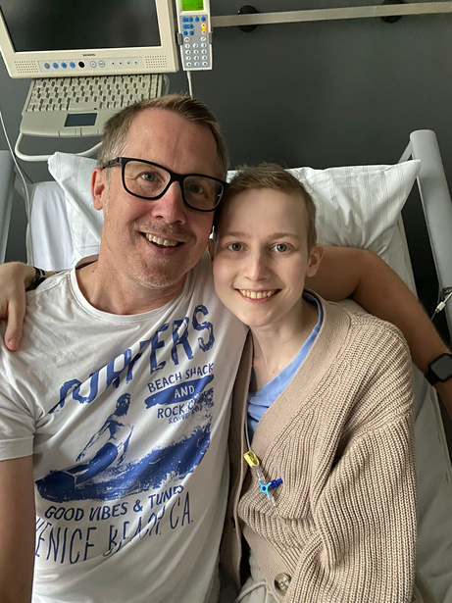
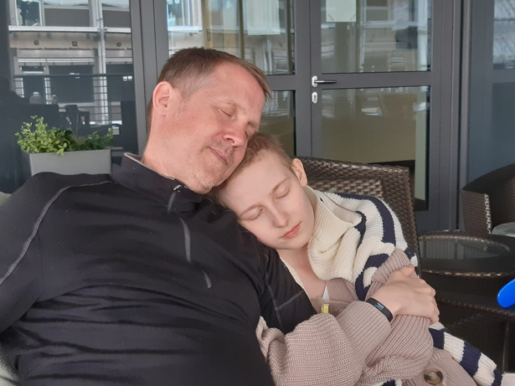
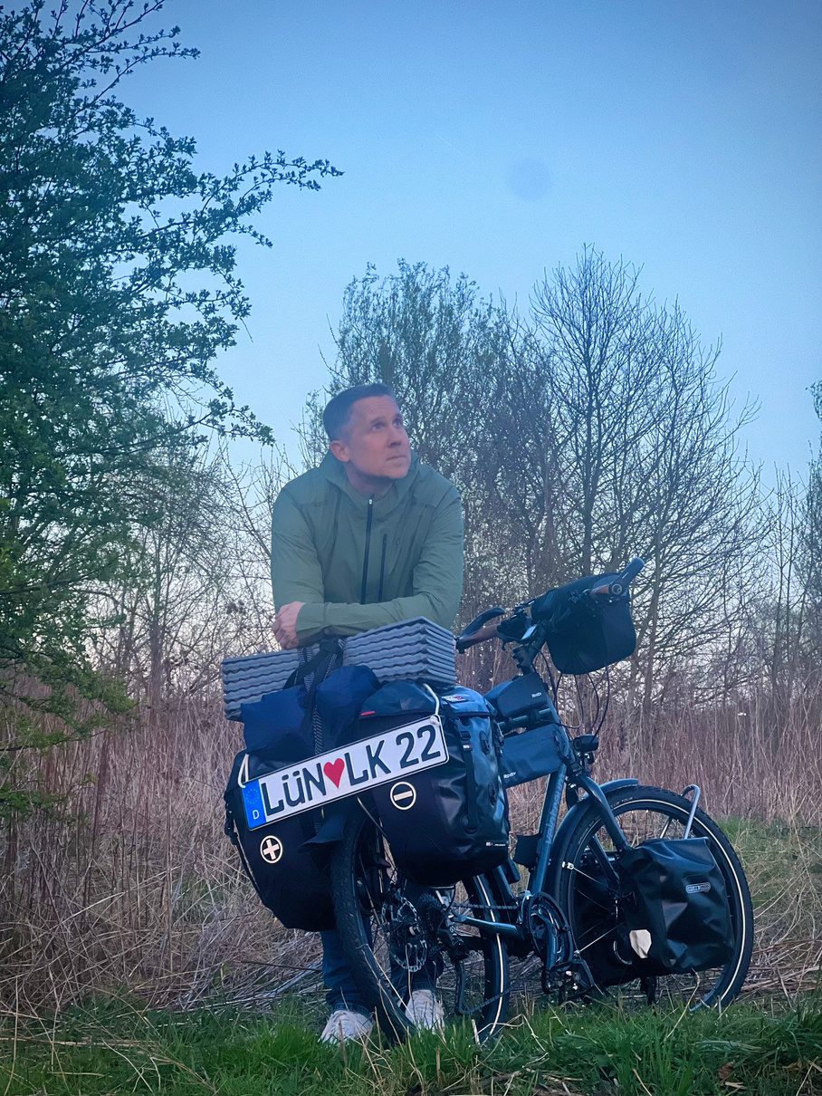


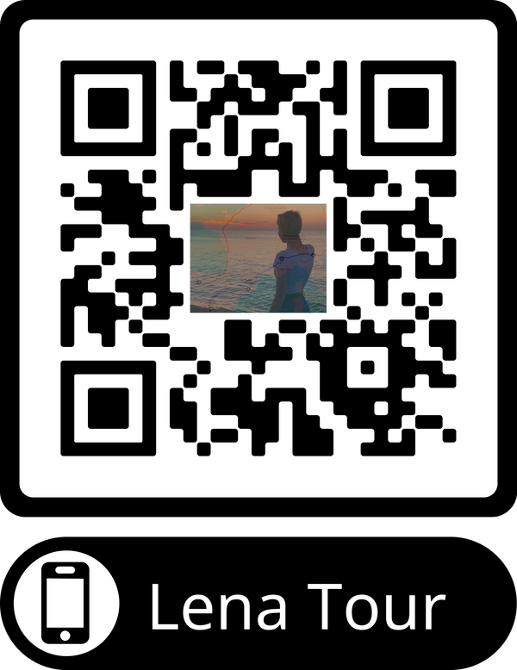




Lenas Points of View:
A fundraising tour across Europe
Lena died at the age of 22 from the rare cancer sarcoma.
Her parents found a list of places she would have liked to visit.
DONATE NOW!
Her father Heiko will now visit these places himself.
With his tour, Heiko is collecting donations for the German Sarcoma Foundation.
On the bicycle. Alone. Across Europe.
For Lena.
www.sarkome.de
sarkome.de
paypal.me/lenatour

Slide 5
#UNTILTHERESACURE

